Slide 1

Name of the School: School of Computer Science and Engineering
Course Code: E2UC201C Course Name: Object Oriented Programming
Language Translator
Guided By :
Mr. Gurpreet Singh
Presented By :
Vidushi Singh
23SCSE1180404
Sarthak Bhargav
23SCSE1180455

Slide 2
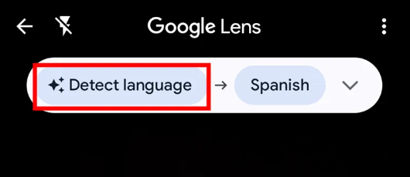
Name of the School: School of Computer Science and Engineering
Course Code: E2UC201C Course Name: OOPS
Problem Statement
Language Translation Program
Developing a program that helps users translate English phrases into either French or Spanish easily.
Objective: Create a straightforward tool that allows users to translate English phrases into French or Spanish directly from their computer, making it convenient for everyday translation needs.

Slide 3
Name of the School: School of Computer Science and Engineering
Course Code: E2UC201C Course Name: OOPS
Flowchart:
start
Initialize the instance
Display the welcome message
setting the while loop for true ,access the display menu and display input option to user
input
Access the respective function
Input =1
Input =3
Input =2
Initialize the French translator object
Input=any other number than 1,2,3
Initialize the Spanish translator object
Access fun. add_new_translation
If input is not in translation dictionary
Print exit
Take input in english
Input word and its translation
Take input english
If input is not in translation dictionary
Display translation not found
Print in french
Display translation not found
Display Translation
Print in spanish

Slide 4
Name of the School: School of Computer Science and Engineering
Course Code: E2UC201C Course Name: OOPS
Technology Used
basic Pseudo Code
Start the program
Setting the while loop on true,display the welcome message .
Then inside the while loop,with the help of if ,else give user the option for input.
THE MAIN MENU THAT WILL BE DISPALYED IS:
1=translate to French.
2=translate to Spanish.
3=add new translation.
4= exiting the translator.
6. Then if the user choose input 1/2,initialize the translator object with a given translation dictionary.
(translation_dict=a dictionary containing word translation )
Translate the given text using the translation dictionary either it be Spanish or French.
then according to input, the respective translator will be initialize with predefined translation.
But if the input is not available in the dict the it will display translation not found.
If the user choose input 3, for adding new word in the dictionary.
Word and translation variable will appear to take input from user save them in the dictionary.
But if the user choose input 4,it will display” exiting the language translator”.
If the user input is other than 1,2,3,4,it will display “enter a valid choice”

Slide 5
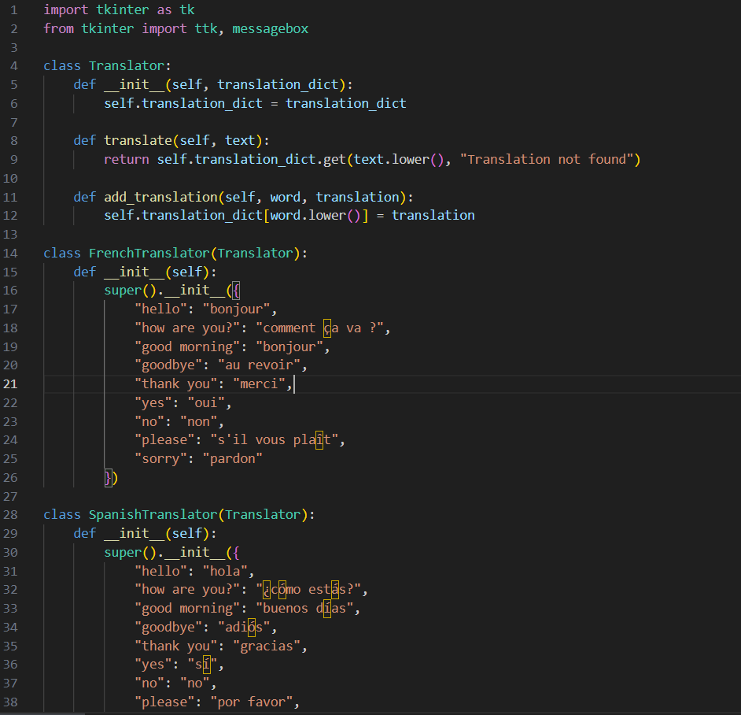
Name of the School: School of Computer Science and Engineering
Course Code: E2UC201C Course Name: OOPS
Technology Used
Source Code

Slide 6
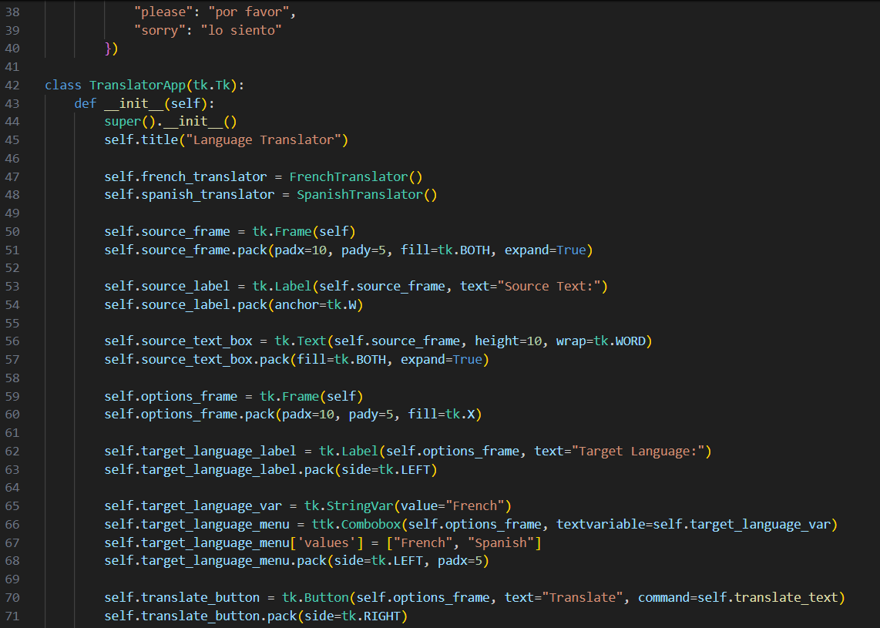
Name of the School: School of Computer Science and Engineering
Course Code: E2UC201C Course Name: OOPS
Technology Used
Source Code

Slide 7
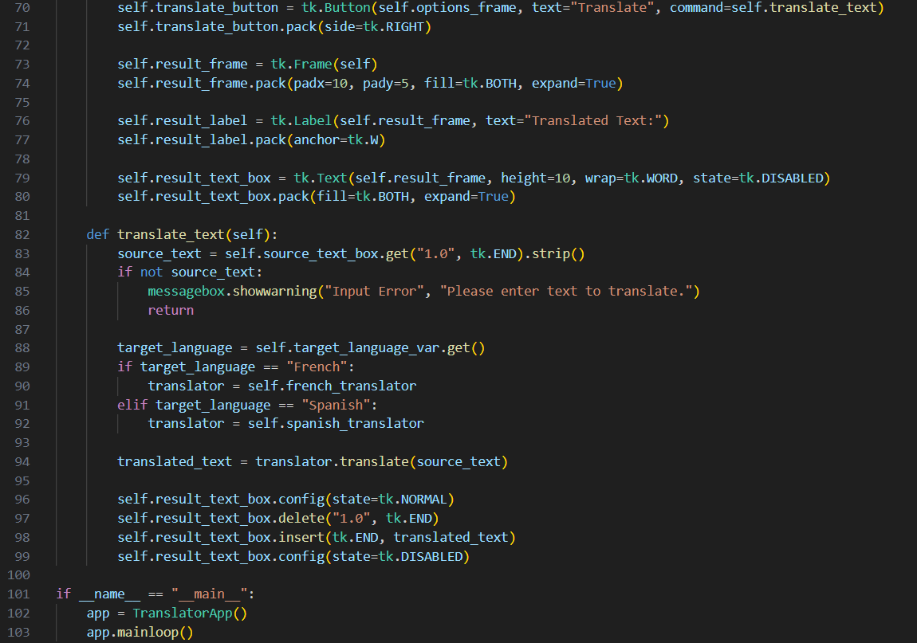
Name of the School: School of Computer Science and Engineering
Course Code: E2UC201C Course Name: OOPS
Technology Used
Source Code

Slide 8
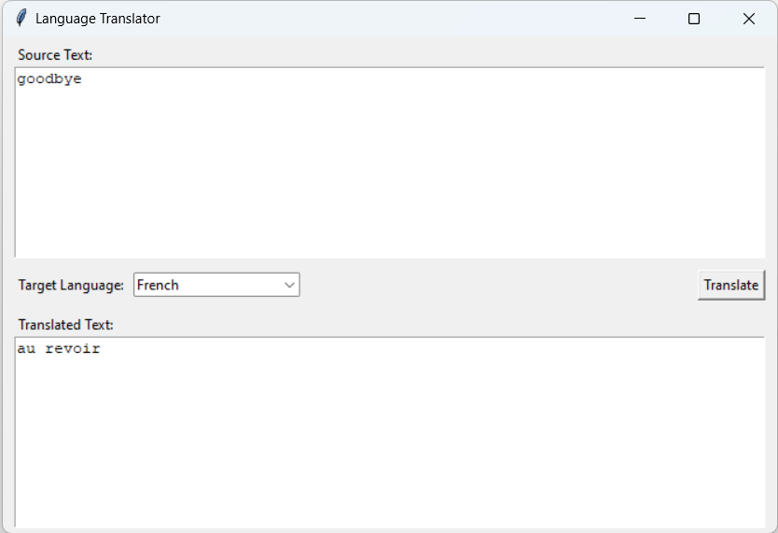
Name of the School: School of Computer Science and Engineering
Course Code: E2UC201C Course Name: OOPS
Output

Slide 9
Name of the School: School of Computer Science and Engineering
Course Code: E2UC201C Course Name: OOPS
Conclusion
The "Language Translator" program helps users translate English text into French or Spanish using an easy-to-use command-line interface.
This program offers an easy and effective way to translate languages like English, French, and Spanish directly from the command line.
It's designed for users who want fast and dependable translations for everyday needs.

Slide 10
Name of the School: School of Computer Science and Engineering
Course Code: E2UC201C Course Name: OOPS
THANK YOU !

